Slide 1

Generative AI

Slide 2

Index
Understanding the basics of generative AI
Applications of generative AI in creative industries
Understanding Llama
Code
Future trends and advancements in generative AI for llama applications

Slide 3

What is Gen AI
Generative AI refers to AI systems that can create new content, such as text, images, or music.
Unlike traditional AI, which typically focuses on recognizing patterns or making predictions, generative AI creates something new.
Examples: Chatbots, image generators, and music composition.

Slide 4
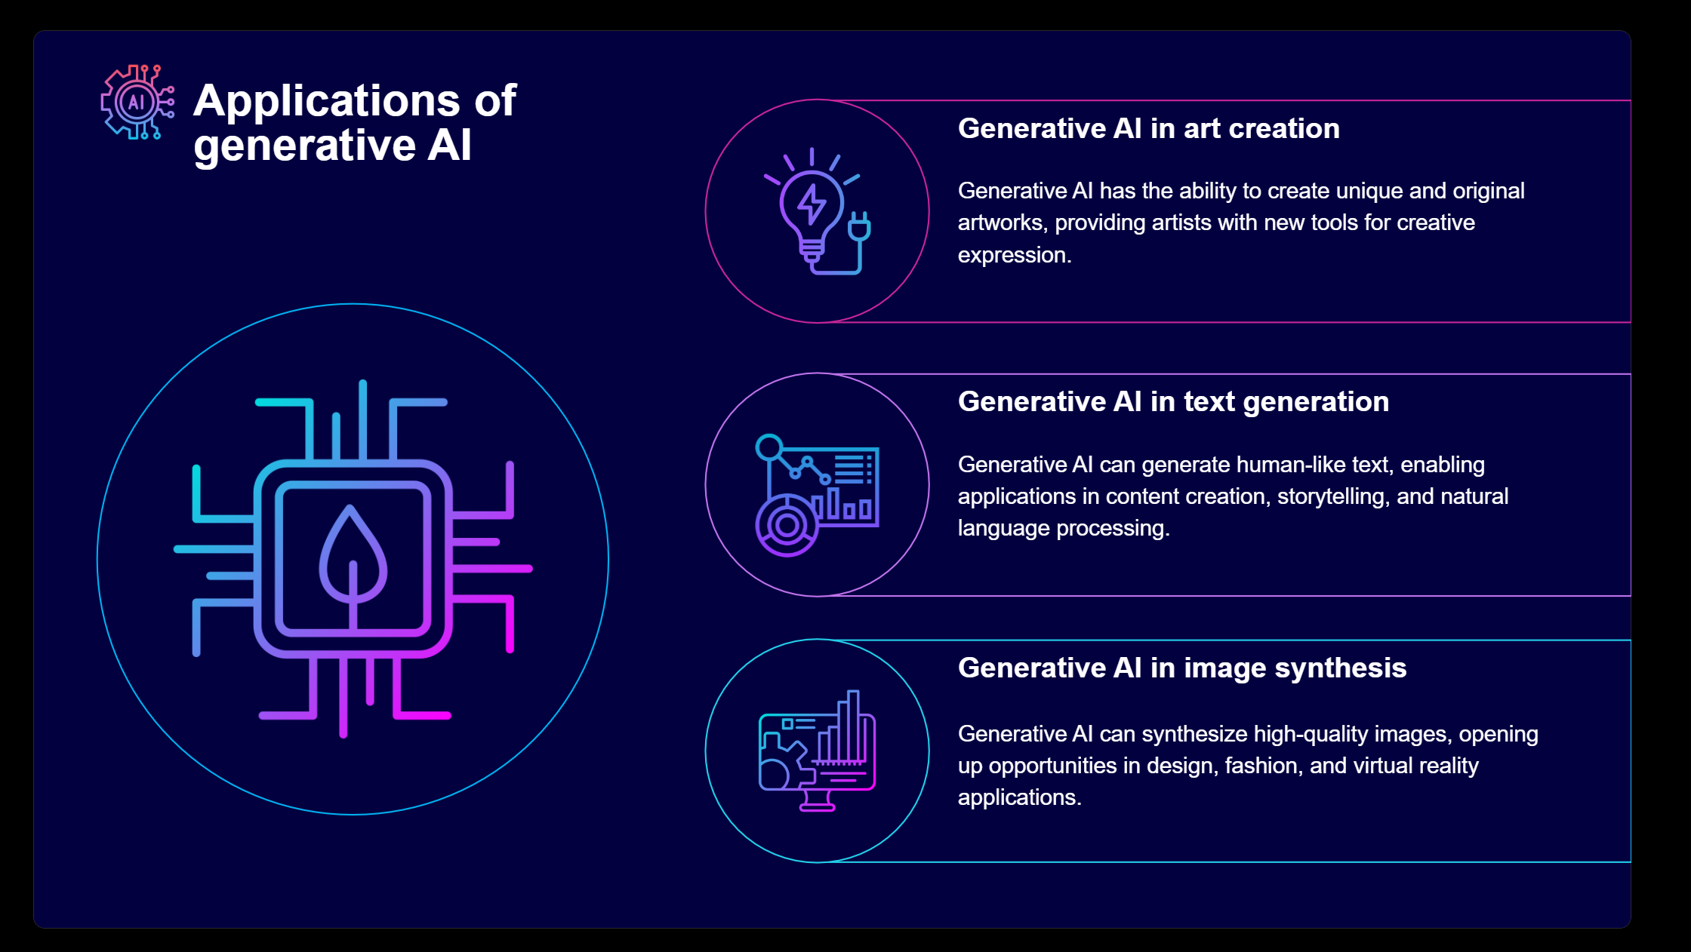

Slide 5
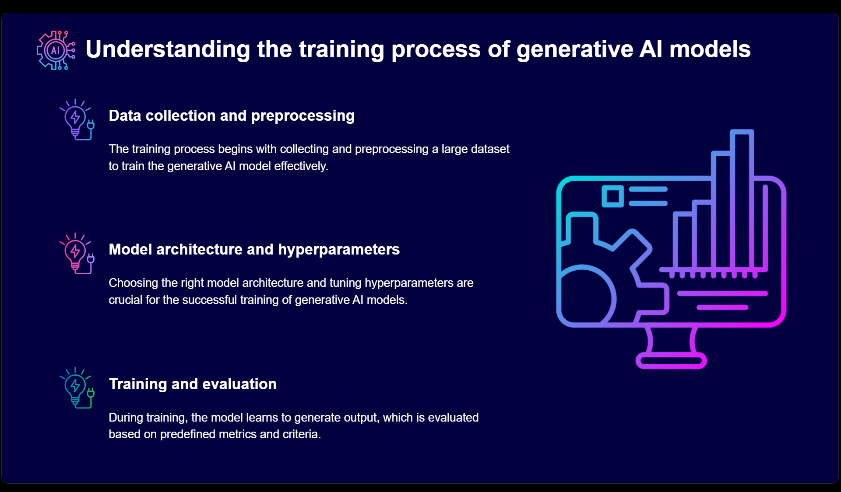

Slide 6
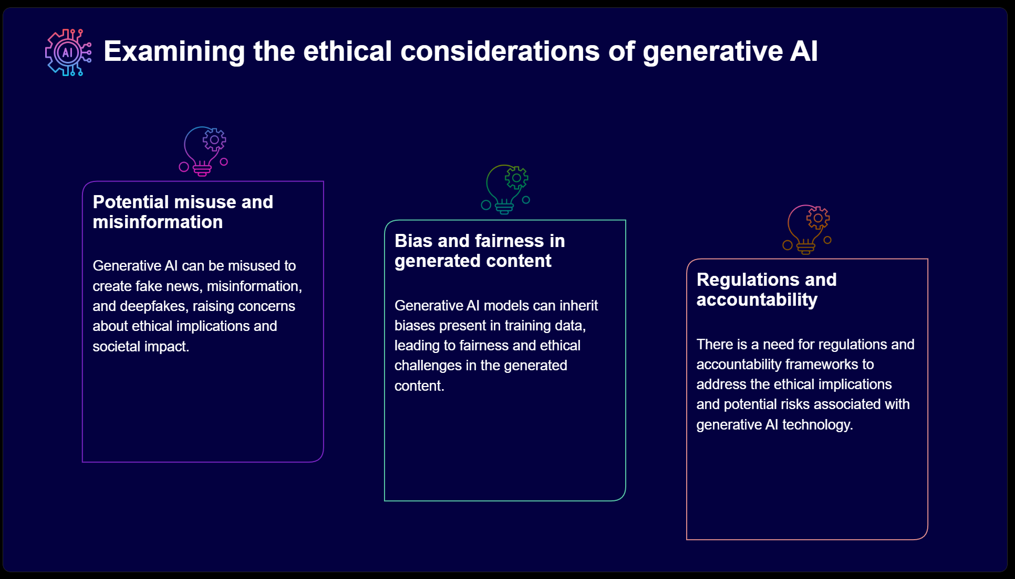

Slide 7
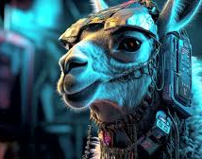
LLAMA

Slide 8
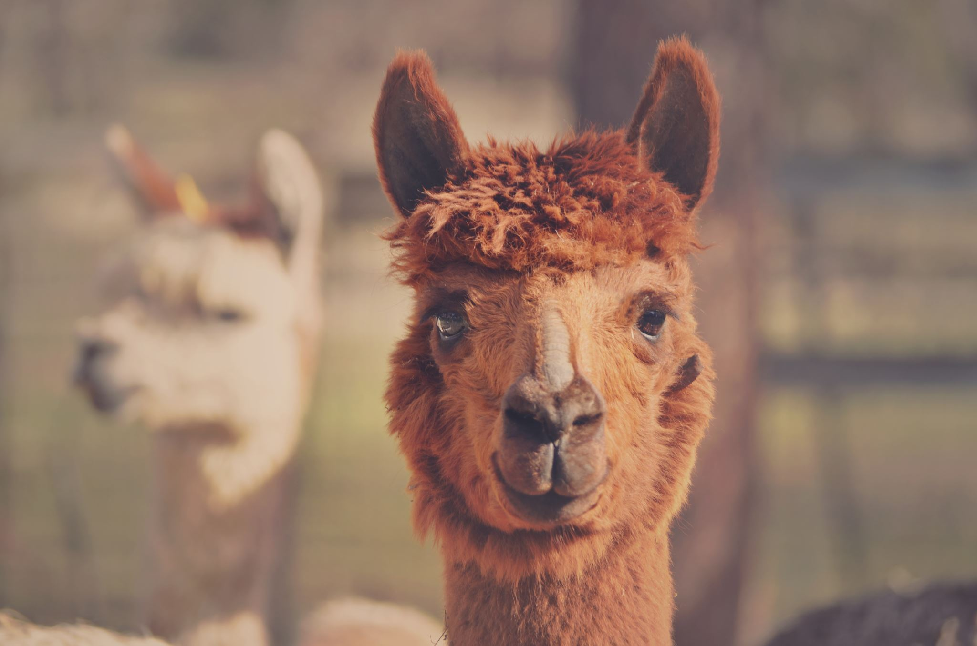
What is llama
LLaMA (Large Language Model Meta AI) is a state-o-the-art language model developed by Meta (formerly Facebook).
It is designed to generate human-like text based on input prompts, similar to OpenAI's GPT-3.
LLaMA is built to be efficient and scalable, making it suitable for a variety of applications.

Slide 9

How LLaMA Works
LLaMA uses the Transformer architecture, which is the backbone of many modern language models.
It is trained on a diverse dataset from the internet, learning grammar, facts, and context.
The model generates text by predicting the next word in a sequence based on the input.

Slide 10




Real World Application
Text Generation
ChatBots
Translation
Education
Writing articles, stories, or code.
Customer service and virtual assistants.
Translating languages while maintaining context.
Creating tutoring systems and personalized learning materials.

Slide 11

CODING

Slide 12
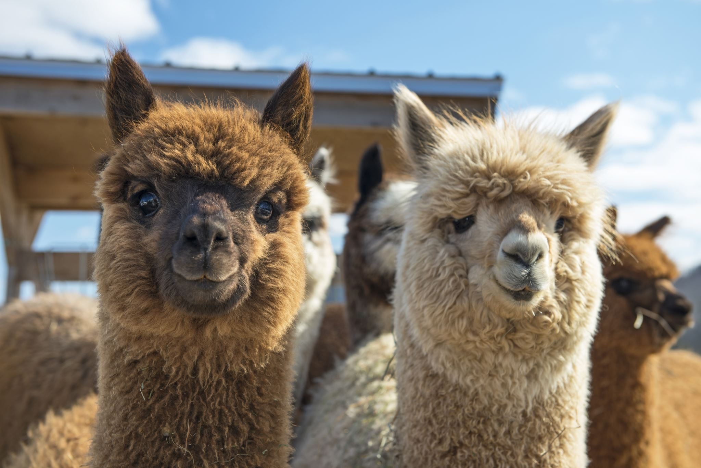
As of now, the LLaMA model by Meta (formerly Facebook) is not available publicly on the Hugging Face Model Hub or any other public repositories due to its licensing and usage restrictions.
However, you can use other open and free models available on the Hugging Face Model Hub. For the purpose of this tutorial, I'll use the GPT-2 model from Hugging Face, as it is freely accessible and serves a similar purpose.

Slide 13
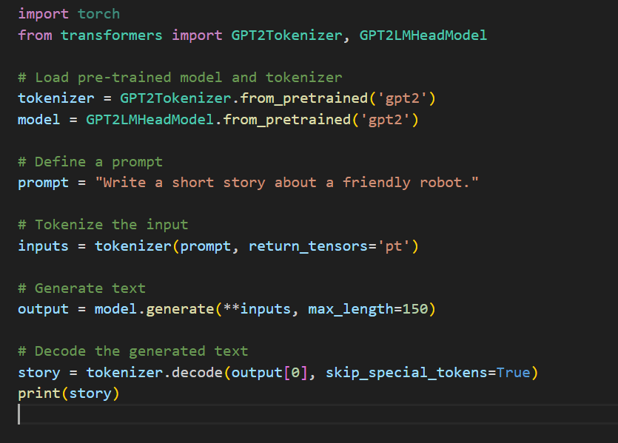

Slide 14
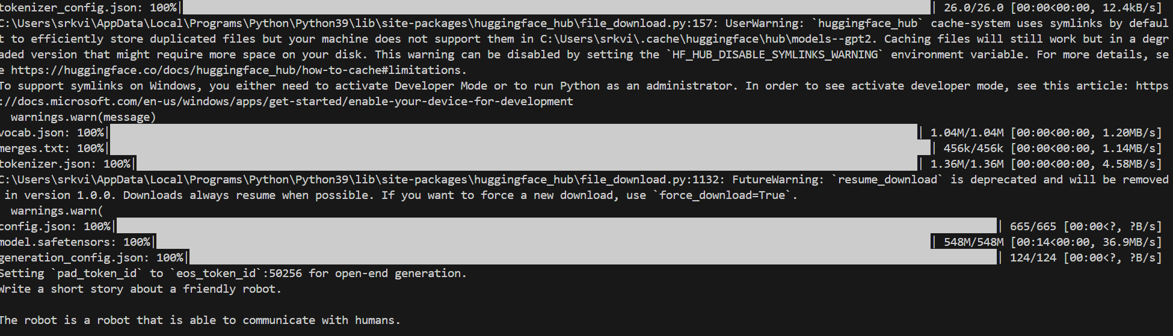
This is the final output

Slide 15

Future trends and advancements in generative AI for llama applications
1. Enhanced Model Efficiency and Scalability:
Optimization Techniques: Continued improvements in model architectures and optimization techniques will make LLaMA modelsto be deployed on a wider range of devices.
Model Compression: Techniques like quantization, pruning, and distillation will make it possible to run large language modelS.
2. Improved Language Understanding and Generation:
Multilingual Support: Enhanced support for multiple languages will allow LLaMA models to generate text in various languages more fluently and accurately.
Contextual Awareness: Future advancements will focus on improving the models' ability to understand and generate text that is contextually aware.
3.Ethical and Responsible AI Development:
Bias Mitigation: Ongoing research will focus on reducing biases in LLaMA models to ensure fair and unbiased text generation.
Transparency and Explainability: Improving the transparency and explainability of LLaMA models will help users understand how the models generate text and make decisions.

Slide 16

Thank you
Mirjam Nilsson​​
206-555-0146​
mirjam@contoso.com​
www.contoso.com​

